Slide 1
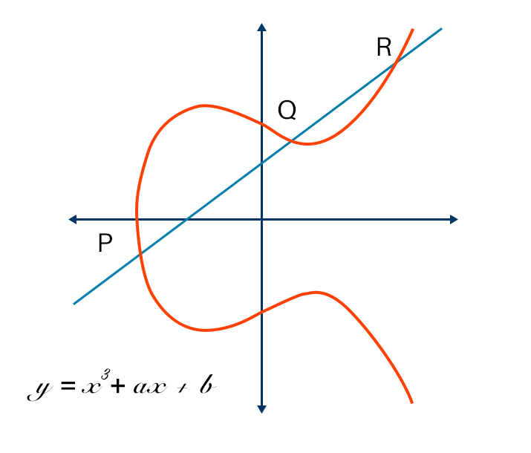

Elliptic Curve Cryptography
Python Presentation Night @ Virtual (PPN #85)
Sebastian Troncoso

Slide 2
What is Elliptic Curve Cryptography?
ECC is a key-based technique for encrypting data. ECC focus on pairs of public and private keys for decryption and encryption of web traffic.
ECC is an alternative technique to RSA.
It is a powerful cryptography approach that required much smaller key sides in compare to RSA keys.

Slide 3
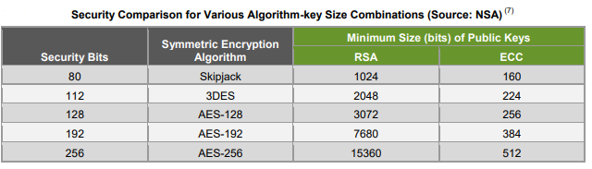

Slide 4
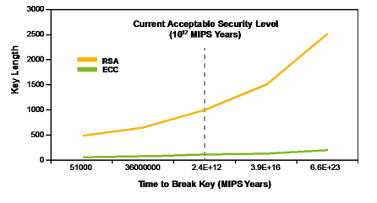

Slide 5
Who uses Elliptic Curve Cryptography?
Google
NSA
Bitcoins
Wikipedia
Facebook

Slide 6



Slide 7
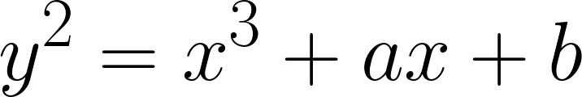
Elliptic curves are the solution of the equation

Slide 8
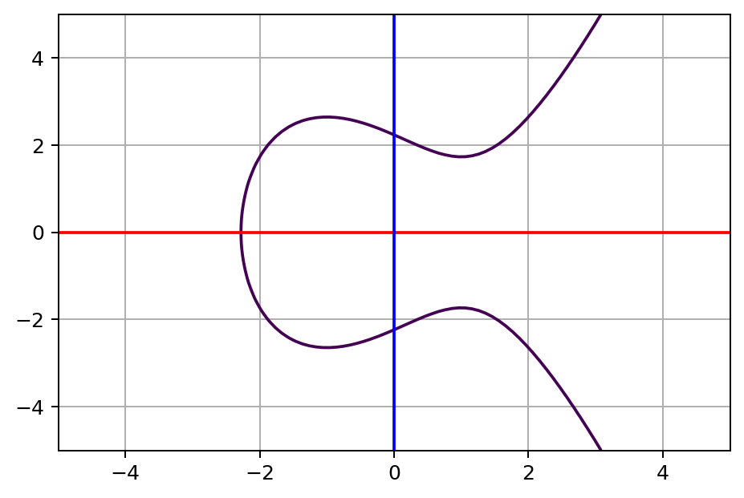
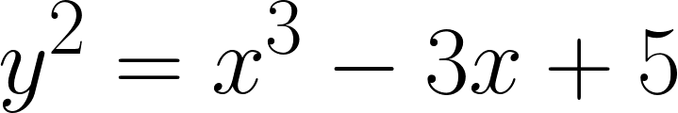

Slide 9
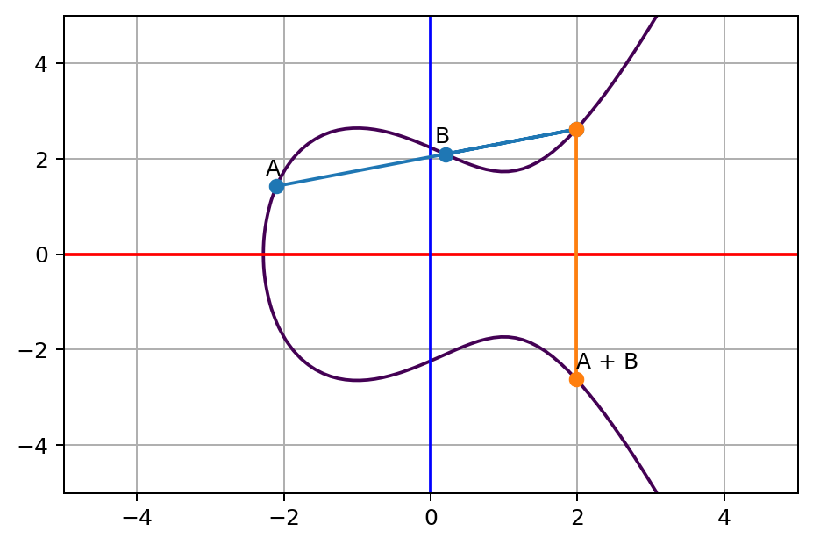

Slide 11
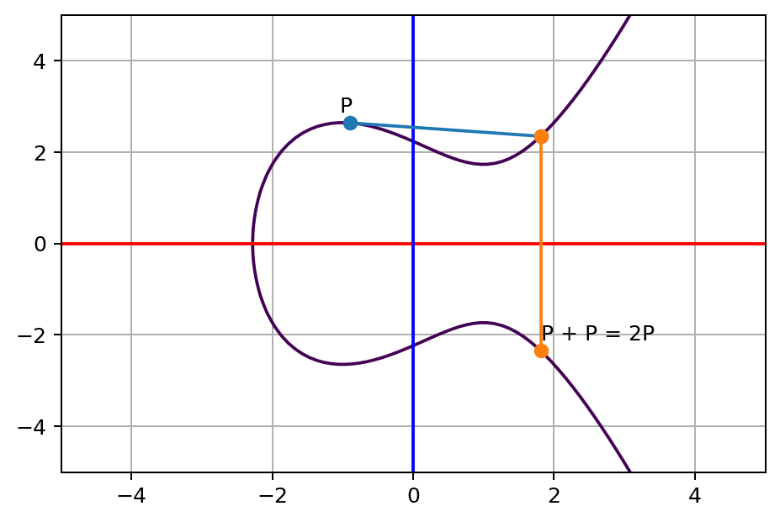

Slide 12
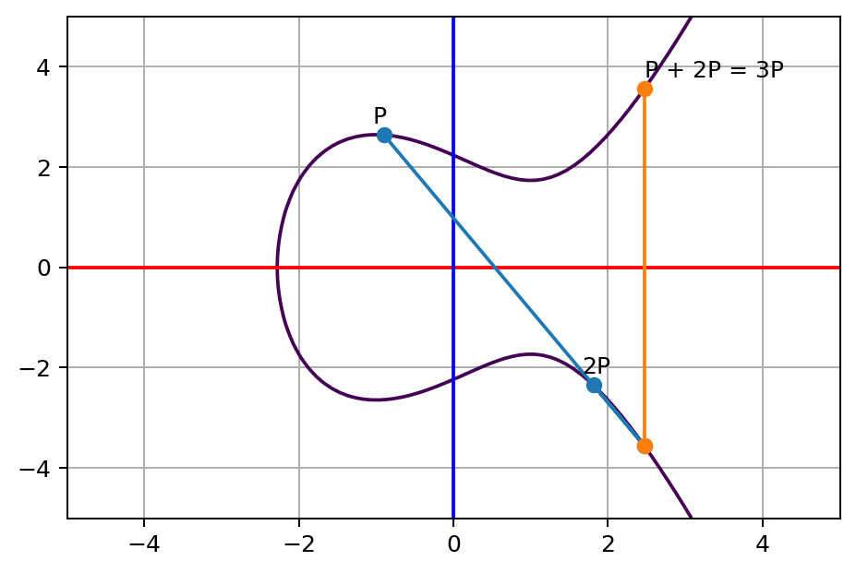

Slide 13
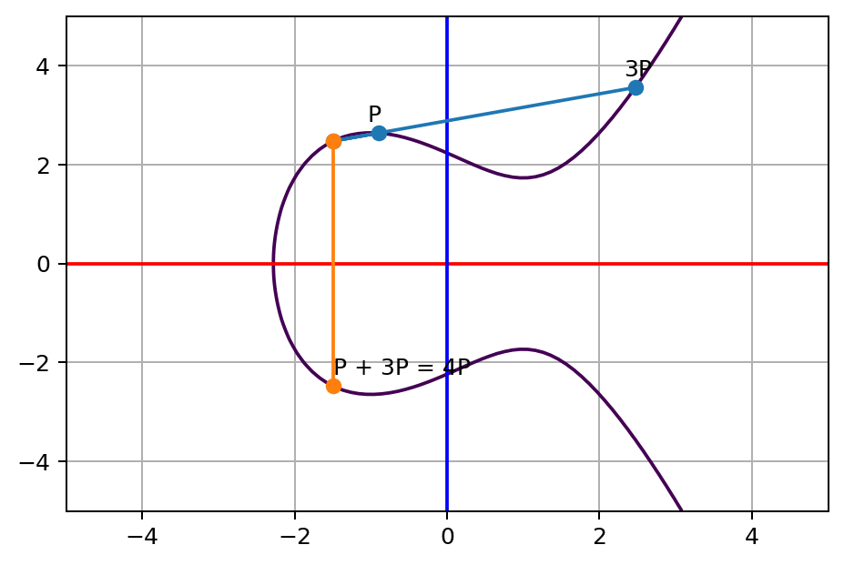

Slide 14
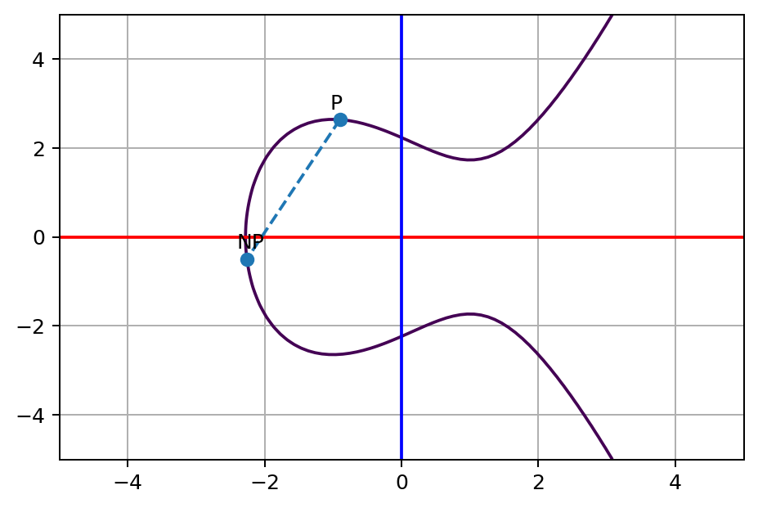
Notes:
8 steps for 227 steps.
227 steps for 10^82.

Slide 15
Given an integer n then it is “easy” to find nP
Given nP then it is extremely hard to find n
Elliptic Curve Discrete Logarithm Problem

Slide 16
Given a elliptic curve and a point P.
Pick a random an integer n
n is the PRIVATE KEY
nP is the PUBLIC KEY

Slide 17


Slide 19
